Slide 1
1:1-12

Slide 2
1:1-12
Now what?

Slide 3
1:1-12

Slide 4
1:1-12
1 Peter 1:13–25 ~ ¹³ Therefore gird up the loins of your mind, be sober, and rest your hope fully upon the grace that is to be brought to you at the revelation of Jesus Christ; ¹⁴ as obedient children, not conforming yourselves to the former lusts, as in your ignorance; ¹⁵ but as He who called you is holy, you also be holy in all your conduct, ¹⁶ because it is written, “Be holy, for I am holy.”
¹⁷ And if you call on the Father, who without partiality judges according to each one’s work, conduct yourselves throughout the time of your stay here in fear; ¹⁸ knowing that you were not redeemed with corruptible

Slide 5
1:1-12
1 Peter 1:13–25 ~ things, like silver or gold, from your aimless conduct received by tradition from your fathers, ¹⁹ but with the precious blood of Christ, as of a lamb without blemish and without spot. ²⁰ He indeed was foreordained before the foundation of the world, but was manifest in these last times for you ²¹ who through Him believe in God, who raised Him from the dead and gave Him glory, so that your faith and hope are in God.
²² Since you have purified your souls in obeying the truth through the Spirit in sincere love of the brethren, love one another fervently with a pure heart,

Slide 6
1:1-12
1 Peter 1:13–25 ~ ²³ having been born again, not of corruptible seed but incorruptible, through the word of God which lives and abides forever, ²⁴ because
“All flesh is as grass,
And all the glory of man as the flower of the grass.
The grass withers,
And its flower falls away,
²⁵ But the word of the Lord endures forever.”
Now this is the word which by the gospel was preached to you.

Slide 7
1:1-12

Slide 8
1:1-12
world ~ kosmos – the system that sets itself up as independent from God
Gal. 4:3 ~ Even so we, when we were children, were in bondage under the elements of the
world.
kosmos.
2 Cor. 3-4 (NASB) ~ ³ And even if our gospel is veiled, it is veiled to those who are perishing, ⁴ in whose case the god of this world has blinded the minds of the unbelieving …

Slide 9
1:1-12

Slide 10
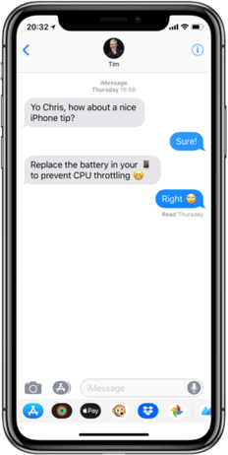
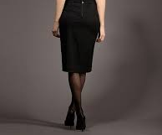
1:1-12
Does this dress make my rear look big?
M
N
oo!

Slide 11
1:1-12

Slide 12
1:1-12
be sober ~ literally be sobering
Merrihew Standard Version ~ Therefore roll up the sleeves of your mind so that you can always be focused and deliberate as you look forward to the day when you see Jesus face to face and His grace will be fulfilled.

Slide 13
1:1-12

Slide 14
1:1-12
lusts ~ epithumia – to burn upon
onomatopoeia ~ “The formation or use of words that imitate the sounds associated with the objects or actions they refer to (e.g. buzz or murmur)”
Luke 22:15 ~ Then He said to them, “With fervent desire I have desired to eat this Passover with you before I suffer;

Slide 15
1:1-12

Slide 16
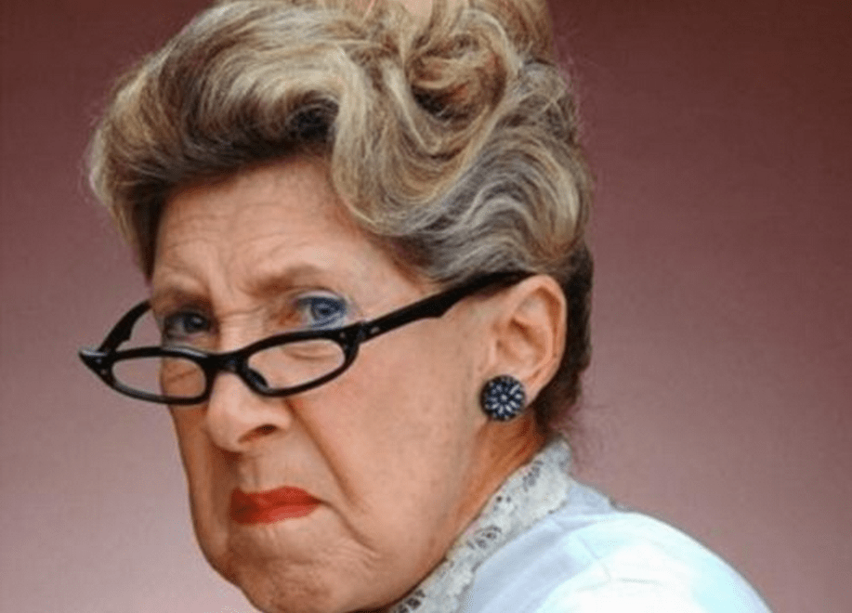
1:1-12
holy ~ hagios – to set apart
Latin ~ sanctus

Slide 17
1:1-12

Slide 18
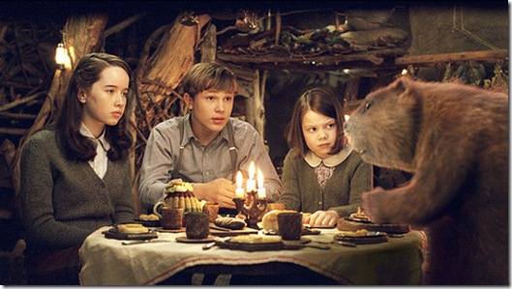
1:1-12
Aslan a man? Certainly not.
I tell you he is the King of the wood and the son of the great Emperor-beyond-the-Sea.
Oohh.
I thought he was a man.
Is he - quite safe? I shall feel
rather nervous about
meeting a lion.
Don’t you know who is the King of Beasts? Aslan is a lion - the Lion, the great Lion.”
Then … he isn’t
safe?
Safe?
Don’t you hear what Mrs.
Beaver tells you? Who said anything about safe? ‘Course he isn’t safe. But he’s good. He’s the King,
I tell you.
That you will, dearie, and no mistake, if there’s anyone who can appear before Aslan without their knees knocking, they’re either braver than most or
else just silly.

Slide 19
1:1-12

Slide 20
1:1-12
precious ~ 8 of the 12x New Testament (NKJV) is in 1-2 Peter
2 Peter 1:10 ~ Therefore, brethren, be even more diligent to make your call and election sure, for if you do these things you will never stumble;

Slide 21
1:1-12

Slide 22
1:1-12
Rev. 13:8 ~ All who dwell on the earth will worship him (Antichrist), whose names have not been written in the Book of Life of the Lamb slain from the foundation of the world.

Slide 23
1:1-12

Slide 24
1:1-12
Calvinism
Salvation
Arminianism
God’s sovereignty
Man’s freewill

Slide 25
1:1-12

Slide 26
1:1-12
purified ~ hagnizō – verb form of hagios
Literally, holified
sincere ~ anupokritos (unhypocritical)
1st love ~ philadelphia – brotherly love
2nd love ~ agapaō – unconditional love
fervently ~ ektenos – from a verb meaning to stretch out the hand

Slide 27
1:1-12
Merrihew Standard Version ~ Since you have set your lives apart in an obedience to what is true through the Holy Spirit with a genuine, unvarnished affection for each other, then press on from a cleansed heart and push forward until that love becomes unconditional.
Warren Wiersbe ~ “The externals of the flesh that divide us are nothing compared to the eternals of the Spirit that unite us.”

Slide 28
1:1-12
The parameters of
Trust in the finished work of Jesus
Christianity
a Christian seminary
a denomination
Agreeing to adhere to a set of beliefs
Agreeing to teach
a set of beliefs

Slide 29
1:1-12

Slide 30
1:1-12
born again ~ anagennaō – to be reborn

Slide 31
1:1-12

Slide 32
1:1-12
Monkeys at the Zoo – (Charlie Peacock)
Will it be different now, or the same?
Will I have learned anything, or was it just a way to spend a day or two set aside for thinking thoughts about you?
If that's all it was I had a good time.
But that won't be enough for me, not this year, not anytime soon,
I have got to clean house, gotta make my bed, gotta clear my head,
It's getting kinda stuffy in here, smells sort of
funky too, like monkeys at the zoo,

Slide 33
1:1-12
Monkeys at the Zoo – (Charlie Peacock)
I have been whoring after things ‘cause I wanna feel safe inside - that's a big, fat lie,
No amount of green, gold or silver will ever take the place of the peace of God.
Spirit, come flush the lies out
Spirit, come flush the lies out

Slide 34
1:1-12

